Slide 1
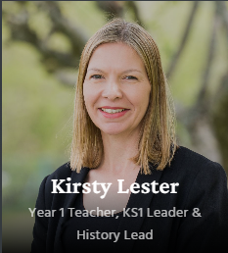
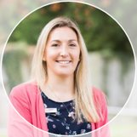
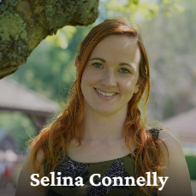
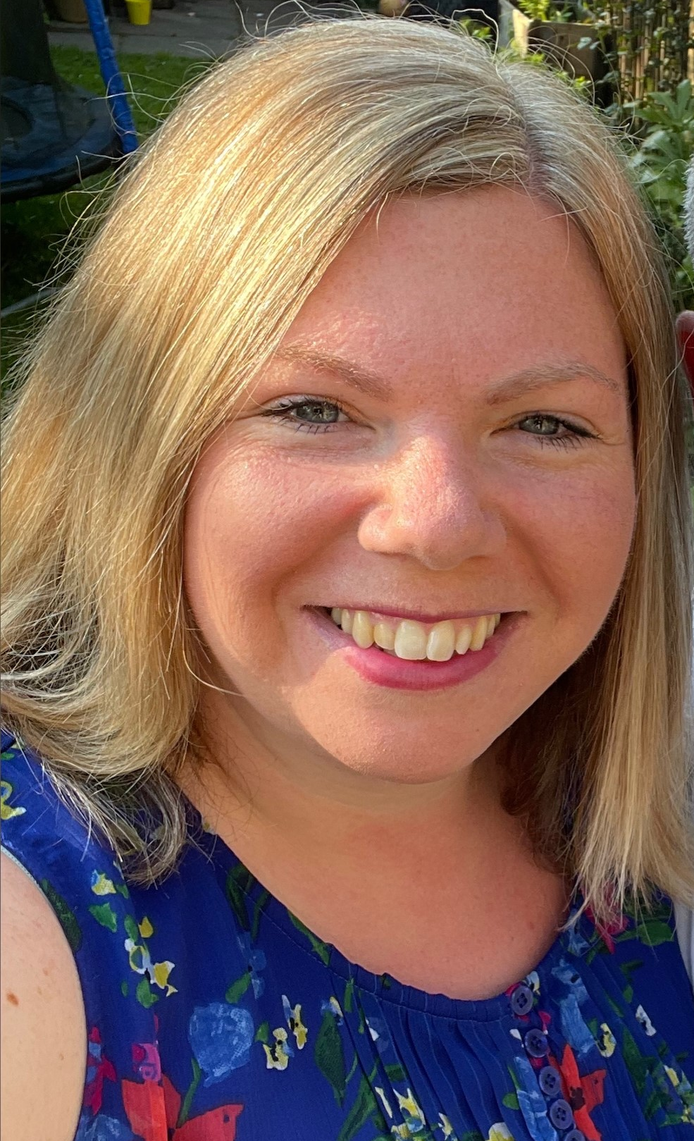
Welcome to the Year 1 transition meeting
Teachers: Teaching Assistants: 1A Mrs Leppard, Mrs Fuller Mrs Connelly
1B Mrs Lester Miss Coomber

Slide 2
In this meeting we will inform you about:
Arrival and collection routine
The Year 1 Curriculum
Uniform
Communication
Safeguarding
E-safety
Ways you can help your child

Slide 4
Arrival :
Just like reception, children go straight into class from 8.30am.
Teacher will greet you in the classroom – please enter via the KS1 entrance next to the dining room.
Starter activities set to help start the day positively and help children settle / Booster groups.
Please sign in at office if late.
Notes:
We will trial this way of starting the day for the first 3 weeks. This is a sensible plan as we don’t know if whole school gatherings in the court in the morning will be a good idea. After 3 weeks we will take a view as to whether this continues.

Slide 5
Collection:
Children collected at 3:30pm from the brown gate behind the dining room.
Please be mindful if you do a 3.30pm pick up, for other children, that some children are still in lessons until 3.45pm and so they must remain with you.
Late Room runs until 3:40 in 2B Clubs.
If your child is being collected by someone else, please inform the office.

Slide 6
Just like in Reception, children will complete focused adult led learning activities interspersed with independent learning opportunities, 'curious learning'. Children will take part in weekly Forest School sessions for the first half of the Autumn term. Children will move from the 7 areas of learning as taught in EYFS to more discreet subjects with cross curricular links.

Slide 7
A Typical Week

Slide 8
Uniform and Equipment:
Things to remember Each day bring a filled water bottle, snack (fresh or dried fruit or cheese) and your bookbag. Please clearly name all belongings.
Monday | Wear PE kit Return and change reading books
Tuesday | Wear PE kit Return library book
Wednesday | Only for the first half of the Autumn Term -wear PE kit all day, bring forest school kit including wellies.
Thursday | Return homework Bring in yellow spelling test books and trainers for the PE lesson.
Friday | New homework set and posted on Firefly

Slide 9
Uniform and Equipment:
Summer uniform is to be worn up to October half term, then winter uniform is to be worn, until the second half of the spring term.​
Book bags are the same as Reception please.
Pencil cases are not required until Year 4.
Named water bottles (changed daily) and snacks of fresh or dried fruit or cheese.
PLEASE MAKE SURE EVERYTHING IS NAMED!

Slide 10
Cross-Curricular Topics:
Autumn Term:
Ourselves
Amazing Animals
Spring Term:
World Explorers
Step Back in Time
Summer Term:
Nature Detectives

Slide 11
Homework:
Each Friday we will post a Homelink letter about the work we have covered in class on the Y1 section of our learning platform, Firefly. It will provide you with details of homework activities and any important dates and information.
Reading
Children will read daily at home. Home reading books will be made up of graded decodable books and a class book to share with an adult, to develop their love of reading. Decodable books will be changed on a Monday, Wednesday and Friday (if required). Each book should be read twice. Class books can be changed as and when children have finished reading them. Please write in your child’s reading diary as reading lottery tickets will be give out for every 10 reads.
Please carry drinks separately to avoid spillages.

Slide 12
Phonic Homework
Each week we will send home a sheet for your child to recap their phonic sounds learnt.
Spellings
Every week, when the children are ready, they will be given some spellings to learn based on work covered in class. A paper copy will be sent home on a Friday and tested the following Thursday. We will send home the spelling test book so that you can monitor the children’s progress.
Other homework will be set from time to time.

Slide 13
Maths Homework
Once a fortnight we will set Maths activities. We would also like the children to use their Mathletics account to practise Mathematics and earn certificates, which are presented every Monday. These can be completed on a PC, laptop or iPad. Details of how to log on can be found in the back of the reading diary.
Children can also access Numbots (a login will be sent home in September)
In all homework activities, please ensure that the children use their neatest handwriting and always write in pencil.

Slide 14
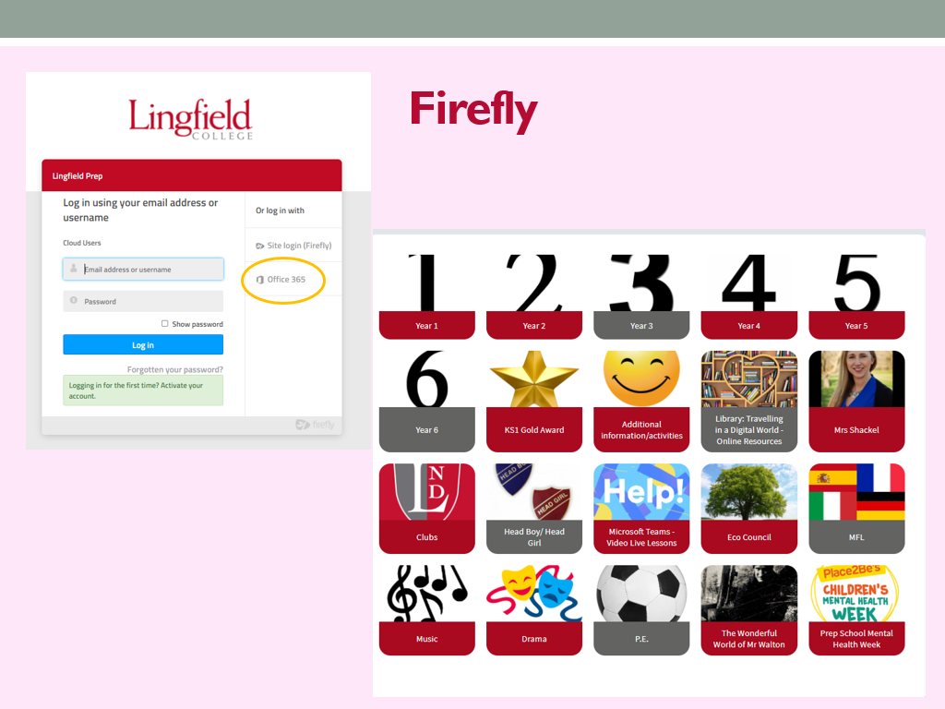
Homework
Every evening - Children are expected to practise their times tables, and to do 15 minutes of reading.
Plus the following homework tasks (up to 40 mins):
 | Given Out | Handed In
English x1 (reading comprehension or SPaG) | Mon | Thurs
English: Spellings to learn plus related activity. | Mon. | Test following Mon.
Maths x2 | Tues | Fri/Mon
MFL | Day of Lesson | Friday (same week)
Occasional Science or Humanities | Day of lesson | One week later.
Instructions will be emailed to you about how to set up a Firefly account.
Maths and English homework books should be covered.
Homework in Year 6 will be assigned on Firefly. Homework diaries will be optional
Notes:
DM

Slide 16
This is an optional activity for KS1 children. During Years 1 and 2, children can work through a series of fun tasks ranging from keeping a weather diary to constructing a parachute and baking. Each time a task is completed, children should show the booklet to their class teacher to earn a star. Children will be given a booklet in which there are a total of 12 activities.
Children may complete some, or all of the activities shown, and will be rewarded for their work.
4 stars = Bronze Certificate
8 stars = Silver Certificate
12 stars = Gold Badge
The award is designed to be completed over 2 years, please do not rush and try and complete all the activities within a couple of months as your child will have nothing to aim for! We suggest 2 activities per term would be suitable for the children in Year 1.
.

Slide 17
You can catch us with small queries in the morning or after school; either the teacher or teaching assistant will be available.
If you require a longer appointment, please either put a note in the book bag/ homework diary or make contact with the Prep Office.
When appropriate we will make comments in your child’s reading diary.
Please read weekly Lingfield Link, homework letters, termly curriculum newsletters etc.

Slide 19
Safeguarding
Safeguarding
There is a tab on the website about this – please take the time to read it.
Mobile Phones – not allowed at all in or around the Foundation Stage (legal requirement).
Videos and Mobile phones – see policy on website. Please do not use cameras in school unless allowed to do so at Productions or special events.
Any photos or videos MUST NOT by uploaded to social network sites (parents always tell us when it happens and who has done it!)

Slide 20
Safeguarding
When coming onsite during the school day (late, early, to drop something off) please go to the office and not to your child’s class.
Nursery parents if collecting or dropping off at lunchtime please do not wander amongst the children on the playground.
Gates – please ensure you close them behind you, especially those around the Foundation Stage which need to be locked.
Any concerns about a child’s welfare please raise with the class teacher first and then this will be passed on to the Designated Safeguarding Leader – J. Shackel. Policy on website.

Slide 21
E-safety
In September we will be re-issuing our e-safety agreement for the children in Years 1-6, which will continue to be age specific.
These will be formally introduced or revisited by pupils in all year groups pupils through a series of cartoon clips during form time.
Children and parents will have to sign the agreements at the start of each academic year (Year 1 – Year 6).
When you receive the agreement please read, discuss and sign it with your child.
School will continue to use the SMART acronym as the basis for these rules.
S (safe) M (meeting) A (accepting) R (reliable) T (tell)
More information about the SMART principles will
be sent with the agreement in a parent mailing in
the first week of the Autumn Term.

Slide 22
Class Teacher
Set Teacher
Specialist Teacher
Head of Key Stage, Mrs Lester
Academic – Director of Studies, Christina Hubbard
Pastoral – Head of Prep School, Mrs Shackel
We firmly believe that a problem
shared is a problem halved!
Notes:
Alison

Slide 23
Ways to help
Encourage a quick and positive ‘goodbye’ in the mornings.
Name all items of clothing and PE kits clearly.
Daily reading (10 mins) and spelling practice. Support with homework as required.
Encourage children’s interest in our topics e.g. bring in artefacts, library books etc.
Notes:
Line each

Slide 24
Any Questions?

Slide 25
Finally….
Have a lovely Summer break, and we look forward to seeing you all in September!
Please pop Friday 27th September in your diary for our parent's information morning at 8:45am.

