Slide 1
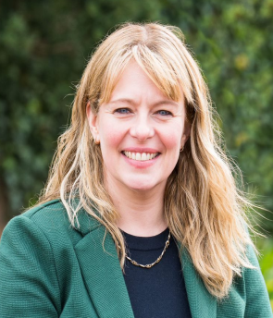
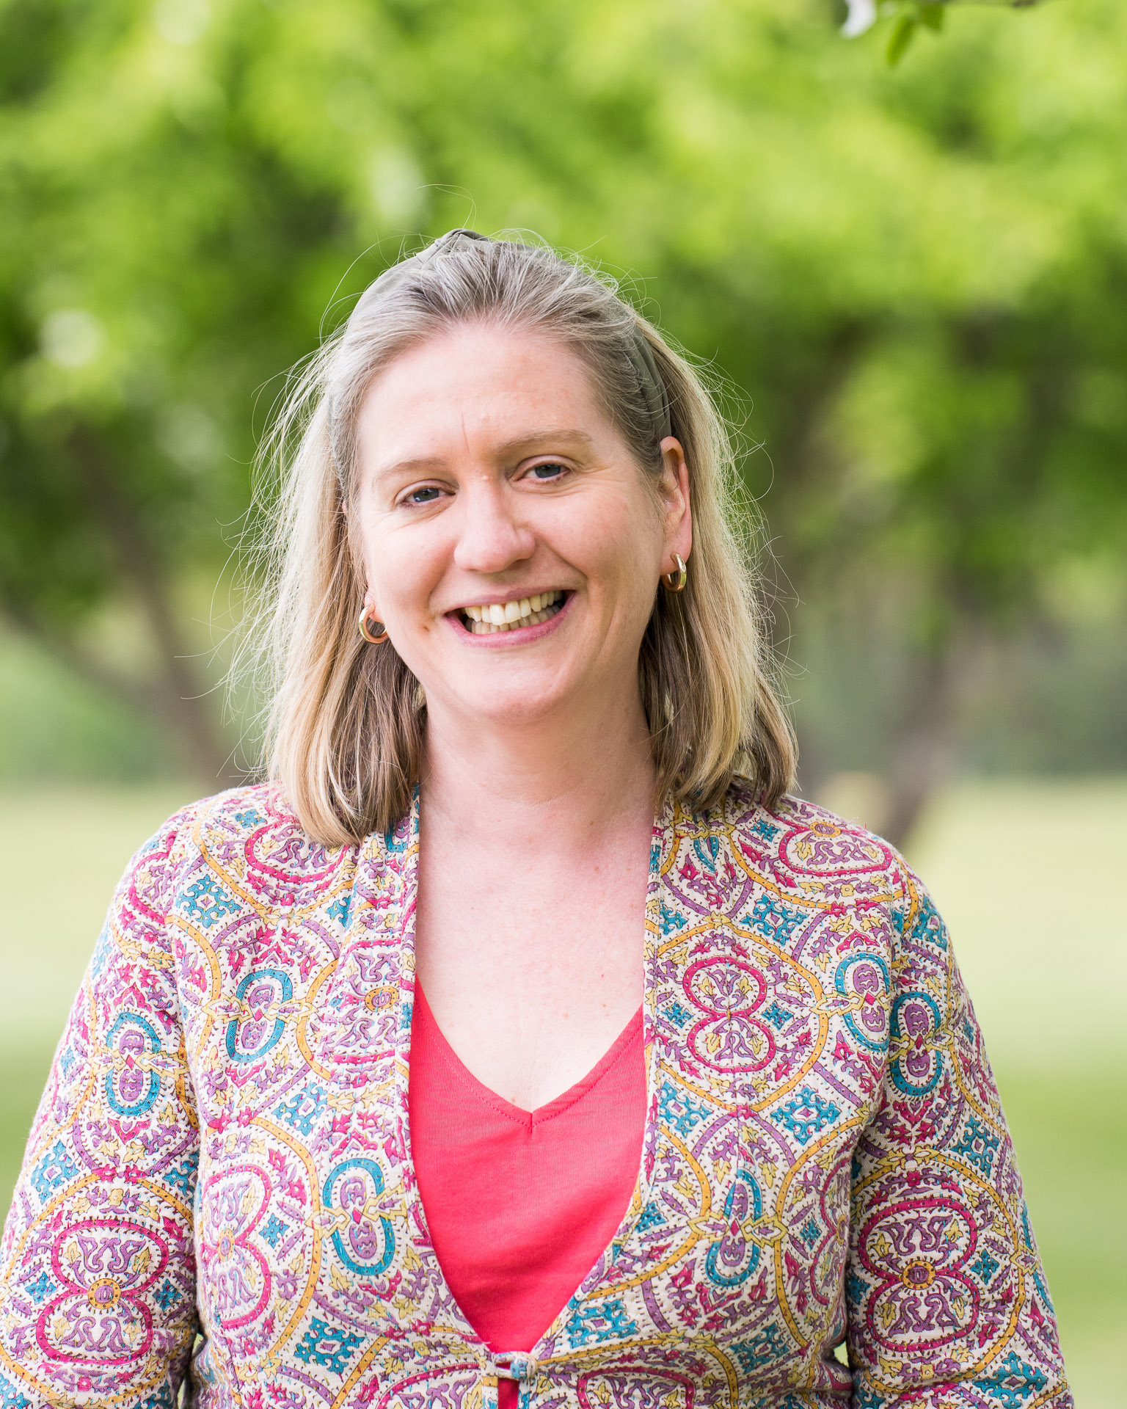
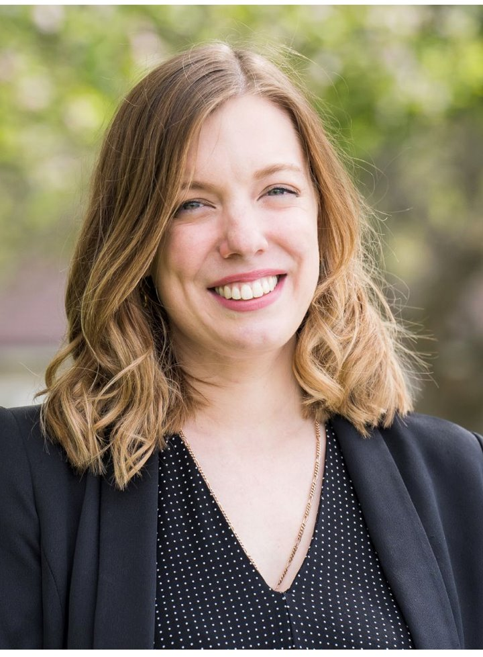
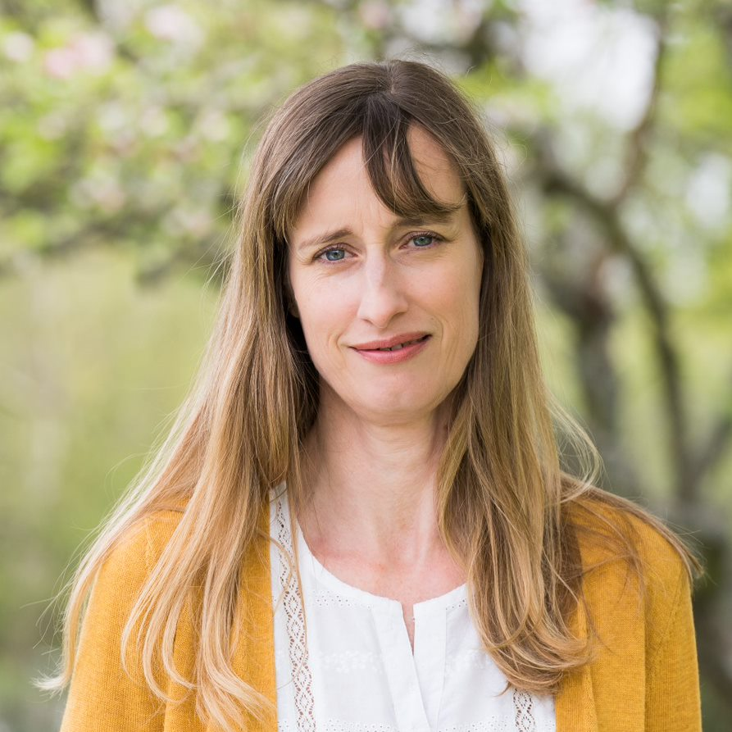
Welcome to the Year 6 transition meeting. Class Teachers: Mrs Roe, Mrs Cooper, Mrs Pearce Teaching Assistant: Mrs Wynn
Notes:
HR intro and intro each teacher – each of us to speak

Slide 2
In this meeting we hope to inform you about:
Arrival and collection routine
Our Curriculum
The weekly timetable (sets)
Expectations and routine for homework and Firefly
Logins
Uniform and equipment needed
Communication with parents
Safeguarding
E-Safety
Questions

Slide 3
Arrival and Collection
Children are able to go straight into class from 8.30am. We would like them to be in class by 8.45am for the day to officially start.
Early Morning Work set to help start the day positively and help children settle.
Please sign in at office if late.
Children collected from the bottom of the staircase (outside by the jockey’s car park) at 3.45pm.
If late your child will be in the office.
Notes:
LL

Slide 4
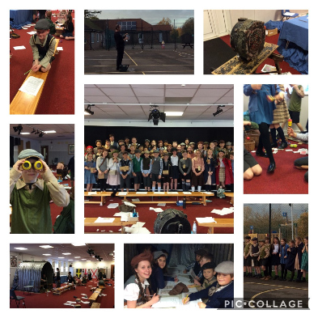
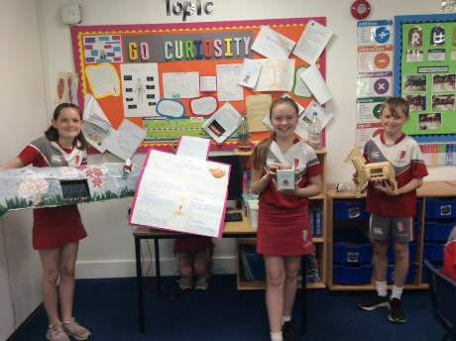
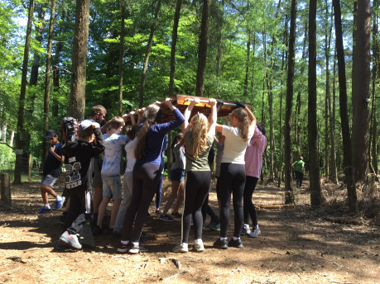
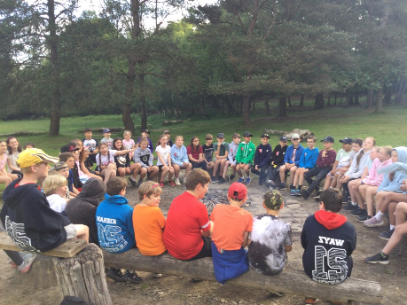
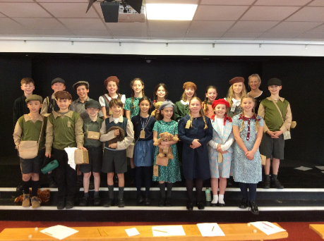
Our Year 6 Curriculum
We have an exciting and engaging curriculum in Year 6:
Autumn Term: The Mayans, Our World in the Future and
Impact of War
Spring Term: UK and map Skills, Protecting the Environment, and Bowles residential
Summer: Production, Enterprise and transition activities
Open Morning - 24rd November and 8th March – Year 6 pupils are expected to attend.
Trips and enhancements: Bluebell Railway and East Grinstead museum, Downe House, Personal Safety workshop, Tandridge Junior Citizen and STEM.
Notes:
HR Our Curiosity Curriculum is a radically different cross-curricular approach that allows children to learn the key skills they need through what interests them most. It gives a huge breadth of learning driven by student choice but within a controlled environment. Pupils travel a 3000 year timeline, choosing topics and subjects they would like to study, and undertake “Challenges” that are designed to promote essential skills. It encourages pupils to manage their own progress and learning.
Sets: Due to changes in year 6 with a move to three classes, we will have four sets in the next academic year. How these will be organised will be finalised closer to the start of the year, with the needs and support of the children firmly in mind and in order to best place the new children. There will continue to be an Embracing set in both English and Maths to assist children with key needs and dyslexia.
Words are assigned on Spelling Shed weekly.
To help children learn their times tables, they can use Times Tables Rock Stars.
Mathletics is assigned fortnightly and can also be accessed at any time for extra practice.
All can be accessed at home (online, on Firefly or on an app).

Slide 5
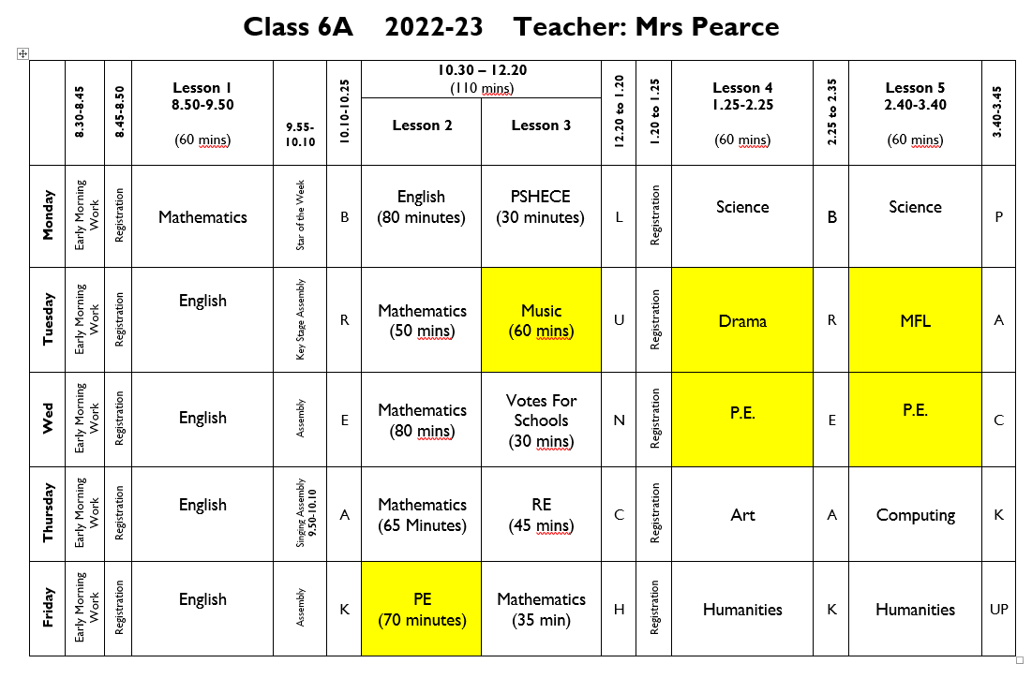
Example Timetable:
Notes:
DM

Slide 6
Homework
Every evening - Children are expected to practise their spellings and times tables, and to do 15 minutes of reading (which will be recorded on Boom Reader).
Plus the following homework tasks (up to 40 mins):
 | Given Out | Handed In
English - Reading Comprehension or SPaG | Friday | Wednesday
Spellings to learn | Wednesday | Test following Wednesday
Maths eg - Video - Worksheet - Mathletics | Friday | Wednesday
Maths Times tables test and TTRockstars | Tested and checked on Friday
MFL | Tuesday | Tuesday
Occasional Science or Humanities | Day of lesson | One week later.
One Word Homework | Once a term | As directed
Maths and English homework books should be covered.
Homework in Year 6 will be assigned on Firefly. Homework diaries will no longer be used.

Slide 7
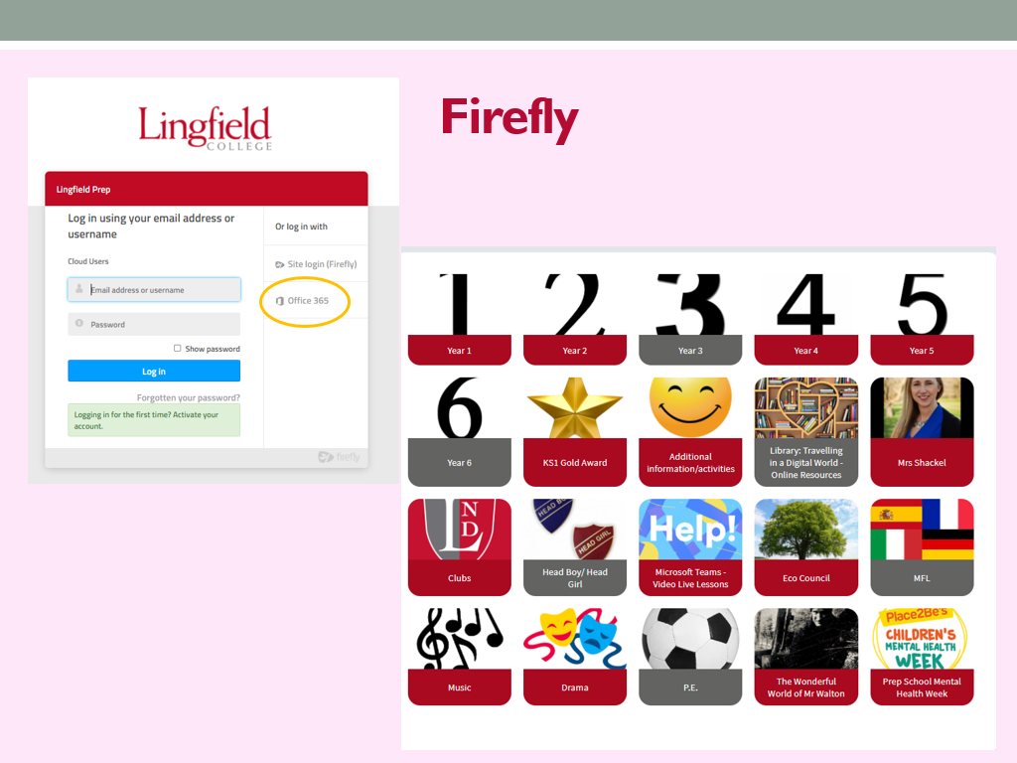
Homework
Every evening - Children are expected to practise their times tables, and to do 15 minutes of reading.
Plus the following homework tasks (up to 40 mins):
 | Given Out | Handed In
English x1 (reading comprehension or SPaG) | Mon | Thurs
English: Spellings to learn plus related activity. | Mon. | Test following Mon.
Maths x2 | Tues | Fri/Mon
MFL | Day of Lesson | Friday (same week)
Occasional Science or Humanities | Day of lesson | One week later.
Maths and English homework books should be covered.
Homework in Year 6 will be assigned on Firefly. Homework diaries will be optional
Notes:
DM

Slide 8
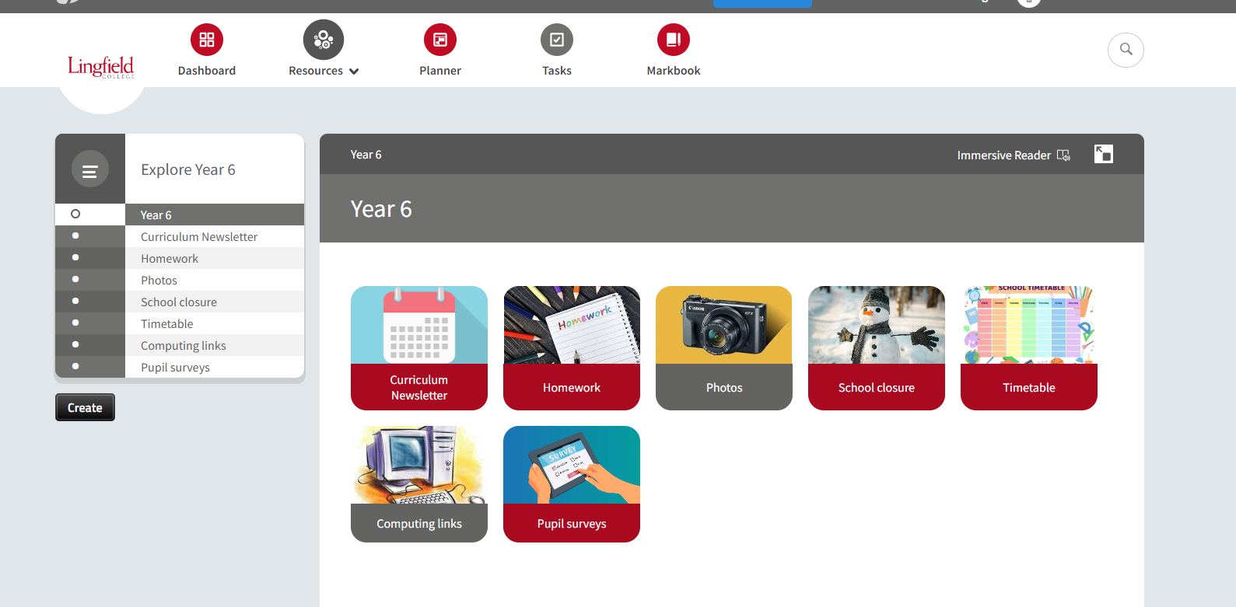
Notes:
DM

Slide 9
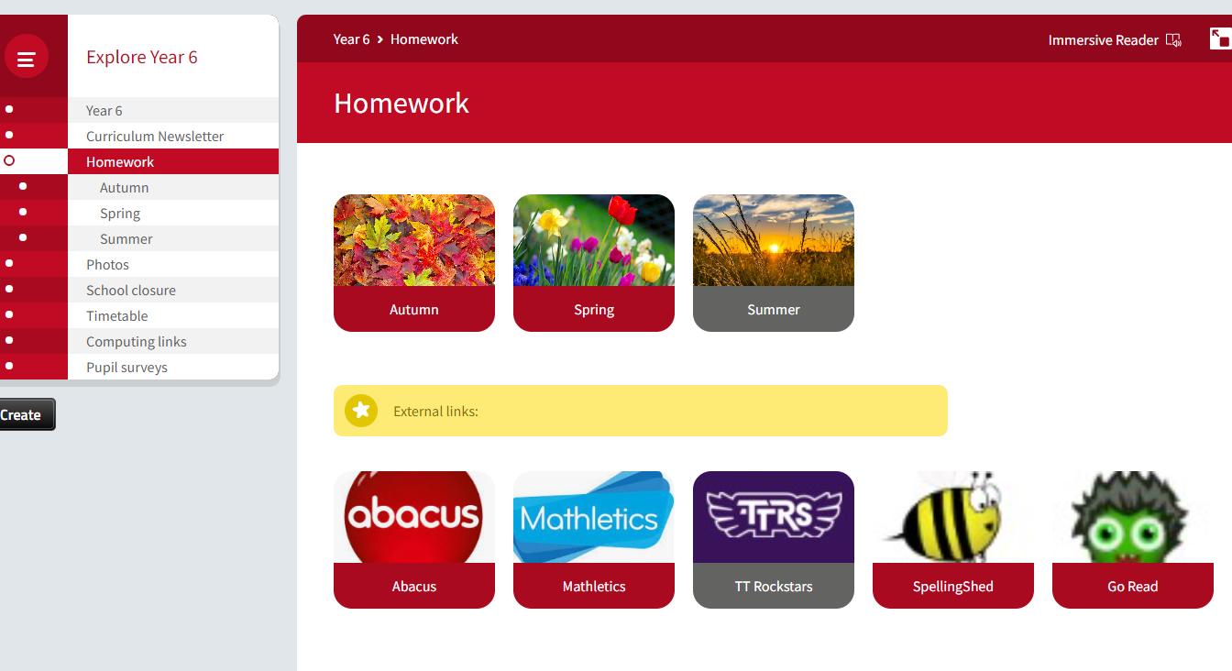

Slide 10
Logins
Many children will already know their login details; however, we will provide them and our new children with a paper copy to keep at home.
They will each have an email address and 4-digit password e.g. 25coopl@lingfieldcollege.co.uk 1234
They will use either this email or other usernames to access:

Slide 11
Uniform and Equipment:
Uniform and PE kit (see lists provided). Wednesday, come in to school wearing PE kit. Friday, come in wearing PE kit but bring uniform to change into.
Art aprons and black coats are needed all year round.
School bag should be the same one used in Year 5, or if a bigger one is needed, a PLAIN BLACK rucksack style bag may be used. There is one available at Simmonds.
Pencil case should contain at least two blue handwriting pens, a purple pen, pencils, a ruler, a rubber, a pencil sharpener and a glue stick.
Musical instruments should be kept in the music rooms and are not allowed in the classrooms.
Water bottles can be kept in classrooms and appropriate snacks can be kept in school bags in the cloakroom.
No electronic equipment, including Apple watches or games.
No bouncy balls or toys with batteries.
Notes:
LL/ AT - PE kit, or uniform if have it, should be worn for first half term. If have PE lessons will need to be in PE kit as won’t be using changing rooms. Depending on situation will decide whether to introduce full uniform after October half term.

Slide 12
Communication:
You can catch us with small queries in the morning or after school; either the teacher or teaching assistant will be available.
If you require a longer appointment, please make contact with the Prep Office.
Other communications include the Weekly bulletin, homework on Firefly, termly curriculum newsletters, etc.
Notes:
HR

Slide 13
Class Teacher
Set Teacher
Specialist Teacher
Head of Key Stage
Academic – Mrs Hubbard
Pastoral – Head of Prep School, Mrs Shackel
We firmly believe that a problem
shared is a problem halved!

Slide 14
Safeguarding
There is a tab on the website about this – please take the time to read it.
Mobile Phones – not allowed at all in or around the Foundation Stage (legal requirement).
Videos and Mobile phones – see policy on website. Please do not use cameras in school unless allowed to do so at Productions or special events.
Any photos or videos MUST NOT by uploaded to social network sites (parents always tell us when it happens and who has done it!)
Notes:
HR

Slide 15
Safeguarding
When coming onsite during the school day (late, early, to drop something off) please go to the office and not to your child’s class.
Nursery parents if collecting or dropping off at lunchtime please do not wander amongst the children on the playground.
Gates – please ensure you close them behind you, especially those around the Foundation Stage which need to be locked.
Any concerns about a child’s welfare please raise with the class teacher first and then this will be passed on to the Designated Safeguarding Leader – J. Shackel
Notes:
HR

Slide 16
E-safety
In September we will be re-issuing our e-safety agreement for the children in Years 1-6, which will continue to be age specific.
These will be formally introduced or revisited by pupils in all year groups through a series of cartoon clips during form time.
Children and parents will have to sign the agreements at the start of each academic year (Year 1 – Year 6).
When you receive the agreement please read, discuss and sign it with your child.
School will continue to use the SMART acronym as the basis for these rules.
S (safe) M (meeting) A (accepting) R (reliable) T (tell)
More information about the SMART principles will
be sent with the agreement in a parent mailing in
the first week of the Autumn Term.

Slide 17
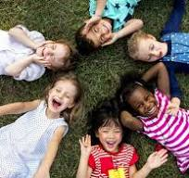
A Key Priority: To embed our EDI provision & establish more opportunities for celebrating the cultural diversity of the school.
To create & sustain an inclusive and contemporary school culture, where diversity, difference and individuality are recognised and celebrated.
Students will…
have a genuine appreciation and respect for different perspectives and be more tolerant and understanding of differences.
be inclusive and empathetic to others.

Slide 18
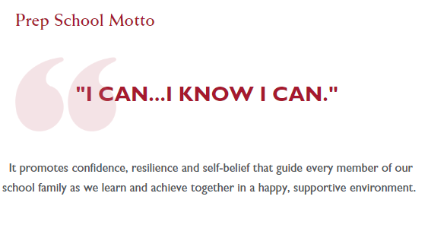

Slide 19
We are very happy to be welcoming your child into Year 6.
It is a very exciting year and we know that they will have fun, learn a lot and mature tremendously over the year.
Any questions and parent rep request?
Notes:
HR

Slide 20
Mrs Roe: roeh@lingfieldcollege.co.uk Mrs Pearce: pearcep@lingfieldcollege.co.uk Mrs Cooper: cooperly@lingfieldcollege.co.uk

