Slide 1
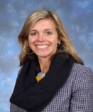
Welcome to the Year 4 Transition Meeting. Teachers: Mrs Barrie 4A Mrs Rees and Miss Marking 4B Teaching Assistants: Mrs Day, Mrs Bennett and Mrs Eakins
Notes:
TB

Slide 2
In this meeting we hope to inform you about:
Arrival and collection routine
The weekly timetable
Maths sets
The cross-curricular topics
Visits and curriculum enhancements
Expectations and routine for homework including spellings and reading
Uniform and equipment needed
Communication with parents
Notes:
JR

Slide 3
Uniform and Equipment:
Summer uniform is to be worn up to October half term, then winter uniform is to be worn, until the second half of the spring term.
Monday - Recorders
Wednesday - Year 4 PE come into school wearing PE kit and change at end of the lesson.
Thursday - Year 4 come into school wearing their PE kit and stay in it all day.
Notes:
JR

Slide 4
Arrival and Collection:
Year 4 should come in through their classroom back door which will be opened by a member of staff at 8.30am each day. At the end of the day, parents can come on site and the children will be released from their back doors at 3:45pm.
Children are responsible for own possessions and should not be in cloakrooms or classrooms before 8.30am.
Please sign in at office if late.
If late your child will be in the office.
Notes:
TB

Slide 5
In a typical week the children will have:
5 x Maths lessons
5 x English lessons
1 x Guided Reading session
2 x Science
1 x Computing
1 x Art or DT
Humanities – 2 x History or Geography
1 x RE
1 x PSHE
2 x PE (Wednesday and Thursday)
2 x Music (Recorders on Monday)
1 x Drama lesson
1 x French
1 x Votes for Schools’ session
Notes:
TB Explain that curriculum newsletter they will receive in September will outline more details.

Slide 6
Class 4A 2024-25 Teacher: Mrs Barrie
 | 8.30-8.45 | 8.45-8.50 | Lesson 1 8.50-9.50 (60 mins) | 9.55-10.10 | 10.10-10.25 | 10.30 – 12.20 (110 mins) |  | 12.20 to 1.20 | 1.20 to 1.25 | Lesson 4 1.25-2.25 (60 mins) | 2.25 to 2.35 | Lesson 5 2.40-3.40 (60 mins) |  | 3.40-3.45
 |  |  |  |  |  | Lesson 2 | Lesson 3
Monday | Early Morning Work | Registration | Maths | Star of the Week | B | Music (35 mins) | English (75 mins) | L | Registration | French | B | Computing |  | P
Tuesday | Early Morning Work | Registration | English | Key Stage Assembly | R | Maths (65 mins) | PSHECE (45 mins) | U | Registration | Art | R | Science |  | A
Wed | Early Morning Work | Registration | Maths (50 mins) | VFS (25 mins) | E | English (55 mins) | PE (55 mins) | N | Registration | Science | E | Music | Drama | C
Thursday | Early Morning Work n | Registration | Maths | Singing Assembly 9.50-10.10 | A | English (110 mins) |  | C | Registration | PE | A | PE |  | K
Friday | Early Morning Work | Registration | English | Assembly | K | RE (45 mins) | Maths (65 mins) | H | Registration | Humanities | K | Humanities |  | UP

Slide 7
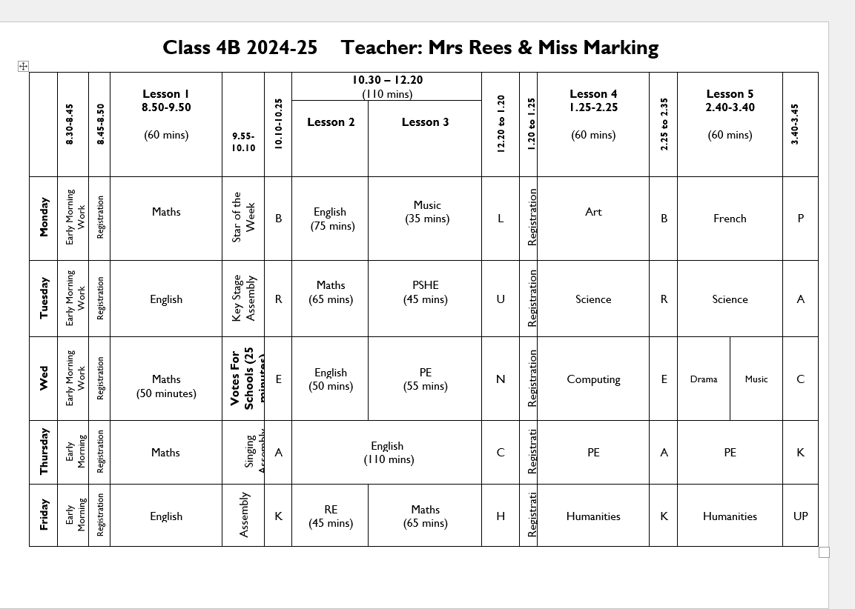

Slide 8
Math and/or English Sets:
We have 2 Maths sets and children will start in sets from September. We will review them at the end of half term.
MTC (Multiplication Tables Check) - the MTC's purpose is to ensure the times tables knowledge is at the expected level.
English will continue to be taught as a class.
In Year 5, the children will be put into sets for English and will continue to be set for Maths.
Notes:
TB

Slide 9
Autumn Term:
How Does the Earth Shake, Rattle and Roll?(Earthquakes and Volcanoes), The Romans
Spring Term:
Anglo-Saxons and Marvellous Maps
Summer Term:
Awesome Ancient Egypt
Notes:
TB

Slide 10
Visits and Curriculum Enhancements:
Autumn Term:
Open Morning - 23rd November
Roman Workshop - 19th November (Roman costume required please)
Spring Term:
Prep School Open Morning – 8th March
Year 4 production
Herstmonceux Science Observatory
Summer Term:
Year 4 Assembly – 13th June
Chiddingstone Castle Ancient Egyptian Day
Notes:
TB

Slide 11
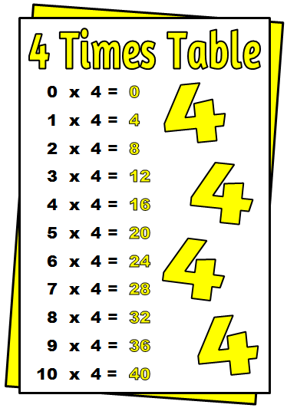
Reading - Please hear your child read on a daily basis. 10 minutes per day is better than a single long session.
Spellings - These will come home on a weekly basis and will be tested the following week, up to 15 spellings. (THURSDAY)
Times Tables/ Mental Maths - Tested on a regular basis. (WEDNESDAY)
Mathletics will continue to be offered across all year groups in the Prep School and Mathletics homework will be set on alternate weeks.
Alternate weeks - English homework will be set that relates to the spellings, PaG or Comprehension.
In addition to Mathletics or English, one piece of topic or Science work will also be set each week.
Please cover children’s homework books.
Children can attend study club in Year 4, where they will be allowed to complete their homework independently.
Notes:
JR

Slide 12
Uniform and Equipment:
Uniform, art aprons, black coat and PE kit
Book bags or rucksacks (not needed but allowed)
Pencil case etc.
School instruments - Music Cupboard
Water bottles (changed daily) and snacks - fruit, vegetables, hard cheese
Toys – only those that fit into a blazer pocket These should not contain batteries and bouncy
balls are not allowed.
Notes:
JR

Slide 13
Notes:
FM

Slide 14
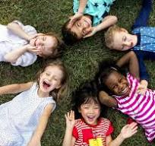
A Key Priority: To embed our Equality Diversity Inclusion provision & establish more opportunities for celebrating the cultural diversity of the school.
To create & sustain an inclusive and contemporary school culture, where diversity, difference and individuality are recognised and celebrated.
Students will…
have a genuine appreciation and respect for different perspectives and be more tolerant and understanding of differences.
be inclusive and empathetic to others.
Notes:
FM Equality, Diversity, Inclusion

Slide 15
E-safety
In September we will be re-issuing our e-safety agreement for the children in Years 1-6, which will continue to be age specific.
These will be formally introduced or revisited by pupils in all year groups pupils through a series of cartoon clips during form time.
Children and parents will have to sign the agreements at the start of each academic year (Year 1 – Year 6).
When you receive the agreement please read, discuss and sign it with your child.
School will continue to use the SMART acronym as the basis for these rules.
S (safe) M (meeting) A (accepting) R (reliable) T (tell)
More information about the SMART principles will
be sent with the agreement in a parent mailing in
the first week of the Autumn Term.
Notes:
JR

Slide 16
You can catch us with small queries in the after school.
If you require a longer appointment, please make contact with the Prep Office.
When appropriate we will make comments in your child’s homework diary or reading record.
Notes:
JR

Slide 17
Please sign the weekly homework letter to show that you have seen it.
You will receive termly curriculum newsletters detailing what we will be learning.
In addition, please read the weekly newsletter (and where appropriate share with your child’s other carers) as this outlines key dates and gives important information such as when home clothes days are taking place.
Notes:
JR

Slide 18
If you have any worries or concerns, please address them to your child’s class teacher in the first instance.
If there are any unresolved concerns after discussion with the class teacher, please contact your child’s Key Stage Leader.
The Key Stage Leader for Lower KS2 is: Mrs Barrie
Notes:
FM

Slide 19
If any concerns remain unresolved, please direct academic concerns to Mrs Hubbard, Director of Studies, and pastoral concerns to Mrs Shackel.
Notes:
FM

Slide 20
There is a tab on the website about this – please take the time to read it.
Mobile Phones – not allowed at all in or around the Foundation Stage (legal requirement).
Videos and Mobile phones – see policy on website. Please do not use cameras in school unless allowed to do so at Productions or special events.
Any photos or videos MUST NOT by uploaded to social network sites (parents always tell us when it happens and who has done it!)
Notes:
TB

Slide 21
When coming onsite during the school day, please go to the office and not to your child’s class.
Nursery parents if collecting or dropping off at lunchtime please do not wander amongst the children on the playground.
Gates – please ensure you close them behind you, especially those around the Foundation Stage which need to be locked.
Any concerns about a child’s welfare please raise with the class teacher first and then this will be passed on to the Designated Safeguarding Leader – J. Shackel
Notes:
TB

Slide 22
We are very happy to be welcoming your child into Year 4.
Any questions?
Notes:
TB

