Slide 1
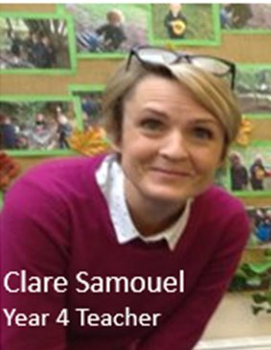
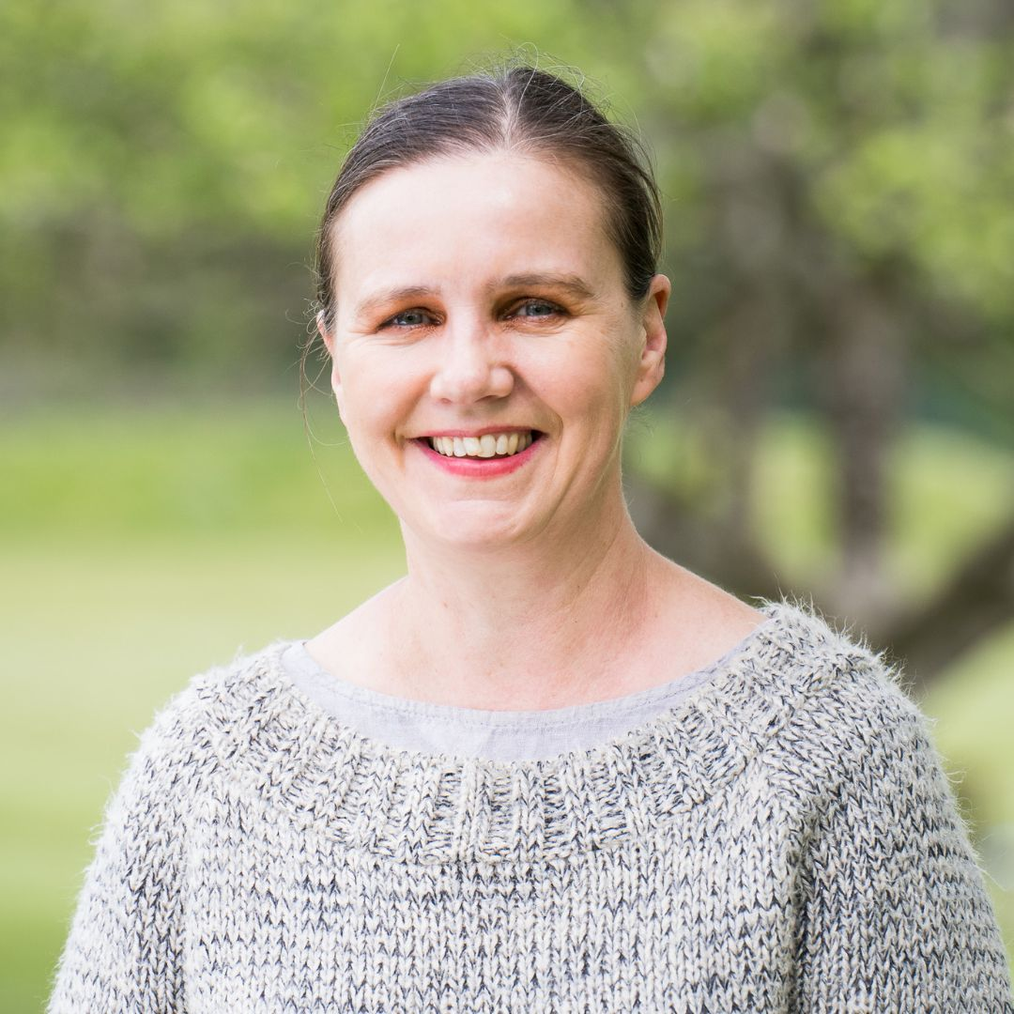
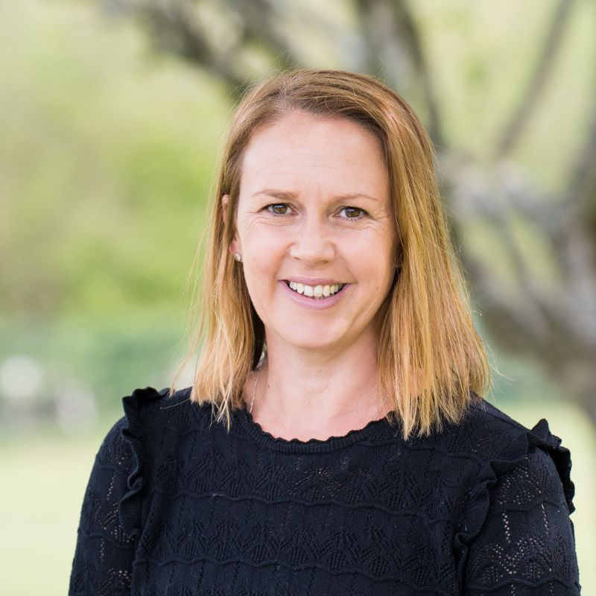
Welcome to the Year 3 Transition Meeting. Teachers: Mrs Edwards 3A Mrs Johnstone and Mrs Samouel 3B Teaching Assistants: Ms Mackay and Mrs George

Slide 2
In this meeting we hope to inform you about:
Arrival and collection routine
The weekly timetable
Maths sets
The cross-curricular topics
Visits and curriculum enhancements
Expectations and routine for homework including spellings and reading
Uniform and equipment needed
Communication with parents

Slide 3
Uniform and Equipment:
Summer uniform is to be worn up to October half term, then winter uniform is to be worn, until the second half of the spring term.
Monday – Pupils come into school wearing PE kit and will change at end of the PE lesson into their uniform
Thursday - Year 3 come into school wearing their PE kit and will go home in PE kit.
Wednesday – Recorder lesson

Slide 4
Uniform and Equipment:
Uniform, including blazer and black coat
Art aprons
PE kit
Book bags
School instruments
Water bottles and a snack (fruit, vegetables or hard cheese)
Toys – only those that fit into a blazer pocket These should not contain batteries and bouncy
balls are not allowed.

Slide 5
Arrival and Collection:
Children should not be in cloakrooms or classrooms before 8.30am
Year 3 pupils should come in through the back door of their classrooms at 8:30am
If your child is late, please sign in at the office.
Pupils are responsible for bringing in their own bags and coats, organising their belongings in the cloakroom and classroom trays.
At the end of the day parents can come onsite and the children will be released from the classroom back doors at 3:45pm.
If you are late, your child will be taken to the office to wait for you.

Slide 6
In a typical week the children will have:
5 x Maths lessons
5 x English lessons
2 x Guided Reading session
2 x Science
1 x Computing
1 x Art or DT
2 x History or Geography (Humanities)
1 x RE
1 x PSHE
2 x PE (Monday morning and Thursday afternoon)
2 x Music (Recorders on Wednesday)
1 x Drama lesson
1 x French
1 x Votes for Schools
Notes:
Explain that curriculum newsletter they will receive in September will outline more details.

Slide 7
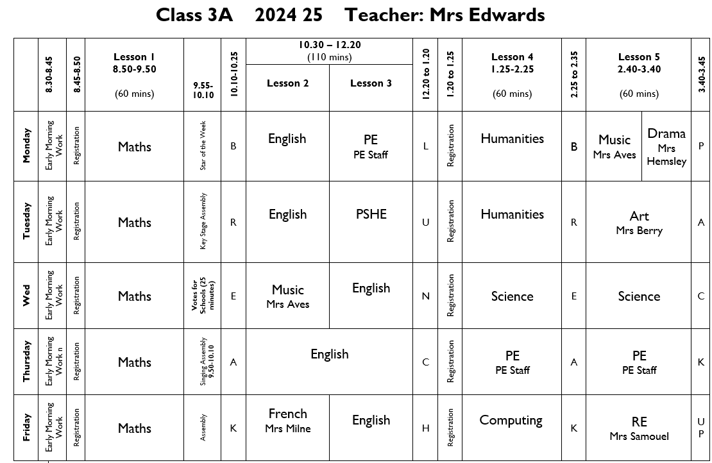
Class 3A 2024-25 Teacher: Mrs Edwards

Slide 8
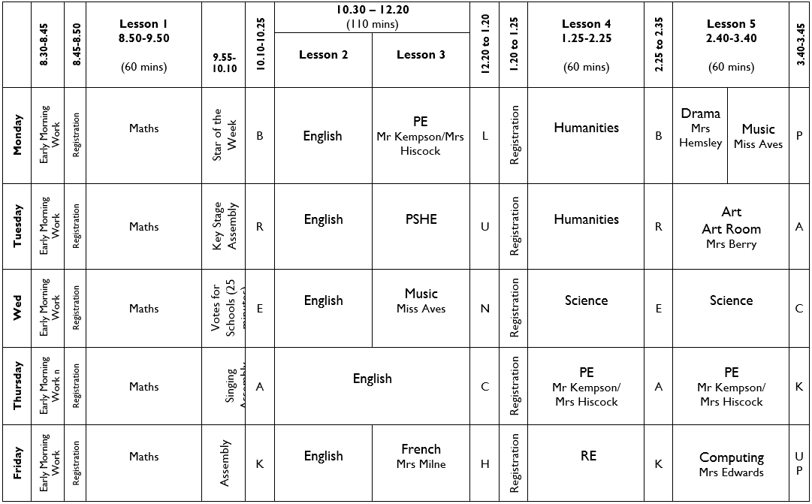
Class 3B 2024- 25 Teachers: Mrs Johnstone and Mrs Samouel

Slide 9
English and Maths Sets:
English will continue to be taught in separate classes.
At the start of the year, children are taught Maths in their own classes and then are put in two sets after the October half term. We will review their progress regularly.

Slide 10
Curriculum Topics
Autumn Term:
From the Stone Age to the Iron Age
Spring Term:
Rivers and Coasts
Summer Term:
The Americas and Rainforests
Local History
Firefly – please check firefly for weekly photo updates

Slide 11
Visits and Curriculum Enhancements:
Autumn Term:
Wilderness Woods
Year 3 Assembly
Open Morning Saturday 23rd November 2024
Spring Term:
Lingfield Church
Open Morning Saturday 8th March 2025
Summer Term:
Wakehurst Place
Lingfield Village

Slide 12
Homework
Please cover children’s homework books
Reading - Please hear your child read on a daily basis and sign the reading log.
Spellings - These will come home on a weekly basis and will be tested the following week, 10 to 15 spellings (tested on a Thursday).
Times Tables - Tested on a weekly basis (tested on a Friday).
Mathletics will be set on alternate weeks.
English will be set that relates to punctuation, grammar or comprehension on alternate weeks.
Homework books due on a Thursday to be checked
Homework books given out (with new homework) on a Friday

Slide 13
Please sign the weekly homework letter to show that you have seen it.
You will receive termly curriculum newsletters detailing what we will be learning.
In addition, please read the weekly newsletter (and where appropriate share with your child’s other carers) as this outlines key dates and gives important information such as when mufti days are taking place.

Slide 15
You can catch us with small queries after school.
If you require a longer appointment, please make contact with the Prep Office.
When appropriate we will make comments in your child’s homework diary or reading record.

Slide 16
If you have any worries or concerns, please address them to your child’s class teacher in the first instance.
If there are any unresolved concerns after discussion with the class teacher, please contact your child’s Key Stage Leader.
The Key Stage Leader for Lower KS2 is: Mrs Barrie

Slide 17
If any concerns remain unresolved, please direct academic concerns to Mrs Hubbard, Director of Studies, and pastoral concerns to Mrs Shackel.

Slide 18
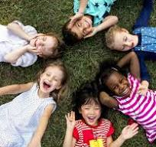
A Key Priority: To embed our EDI (Equality Diversity Inclusion) provision & establish more opportunities for celebrating the cultural diversity of the school.
To create & sustain an inclusive and contemporary school culture, where diversity, difference and individuality are recognised and celebrated.
Students will…
have a genuine appreciation and respect for different perspectives and be more tolerant and understanding of differences.
be inclusive and empathetic to others.

Slide 19
E-safety
In September we will be re-issuing our e-safety agreement for the children in Years 1-6, which will continue to be age specific.
These will be formally introduced or revisited by pupils in all year groups pupils through a series of cartoon clips during form time.
Children and parents will have to sign the agreements at the start of each academic year (Year 1 – Year 6).
When you receive the agreement please read, discuss and sign it with your child.
School will continue to use the SMART acronym as the basis for these rules.
S (safe) M (meeting) A (accepting) R (reliable) T (tell)
More information about the SMART principles will
be sent with the agreement in a parent mailing in
the first week of the Autumn Term.

Slide 20
There is a tab on the website about this – please take the time to read it.
Mobile Phones – not allowed at all in or around the Foundation Stage (legal requirement).
Videos and Mobile phones – see policy on website. Please do not use cameras in school unless allowed to do so at Productions or special events.
Any photos or videos MUST NOT by uploaded to social network sites (parents always tell us when it happens and who has done it!)

Slide 21
When coming onsite during the school day, please go to the office and not to your child’s class.
Nursery parents if collecting or dropping off at lunchtime please do not wander amongst the children on the playground.
Gates – please ensure you close them behind you, especially those around the Foundation Stage which need to be locked.
Any concerns about a child’s welfare please raise with the class teacher first and then this will be passed on to the Designated Safeguarding Leader – J. Shackel

Slide 22
We are very happy to be welcoming your child into Year 3.

