Slide 1
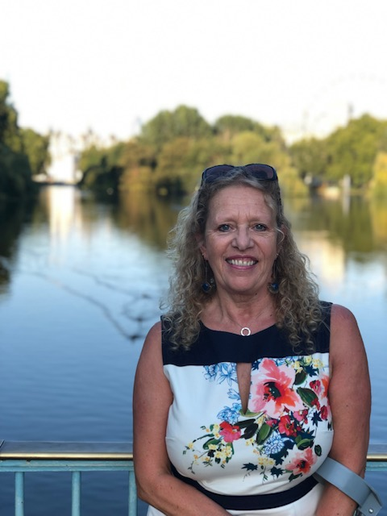
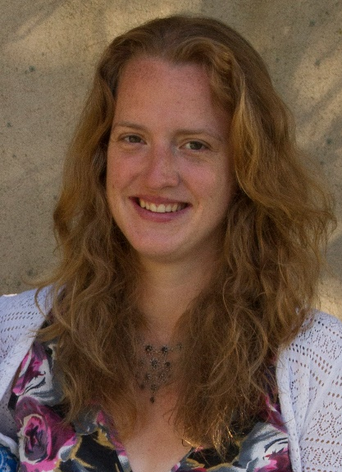
Welcome to the Year 2 Transition Meeting Teachers: 2A = Mrs de Villiers & Mrs Nicholson Teaching Assistant: Mrs Hinkins, Mrs Bennett
Notes:
Daisy

Slide 2
In this meeting we hope to inform you about:
Arrival and collection routine
The Year 2 Curriculum
Uniform and equipment needed
Communication
Safeguarding
Ways you can help your child
Notes:
Louise

Slide 3
Arrival and Collection:
Children will continue to come straight into class from 8.30am. We would like them to be in class by 8.45am for the day to officially start.
A teacher or TA will greet you at the door outside the Dining Hall. All children should wash their hands.
Starter activities are set to help start the day positively and help children settle.
Please sign in at the office if you are late.
Children can be collected from outside the Dining Hall entrance at 3:30.
Notes:
Alison

Slide 4
Collection
If you have a child with siblings in Year 3-6, (3.45pm finish) you are able to use the Late Room. Please pick up your child by 3.40pm.
Children will be escorted to any clubs and T-Rex by a member of staff.
Children will take their belongings with them to their club.
If your child is to be collected by someone else, you need to inform your class teacher and/or the Prep Office.
Notes:
Daisy

Slide 5
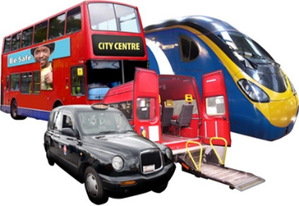
Year 2 Curriculum:
Autumn Term: Oh, I do like to be beside the seaside! This is a topic that we will link to learning in many subjects, such as English, History and Science. Possible Sea Life Centre trip.
Spring Term: India & Transport
Usually, we have an opportunity to dress up for our India Day. We will visit Amberley Transport Museum.
Summer Term: Fire of London & Apprentice Gardeners
We become real gardeners and plant up the Year 2 gardens with vegetables.
We find out about the Fire of London as well as looking at our local area of Lingfield comparing this with London.
In the first half term in Science, we have living eggs in school which we observe hatching and developing.
Notes:
Alison

Slide 6
Uniform and Equipment:
Uniform and PE kit (as explained in Parent mail).
Book bags. The same as Year1 please.
No stationery required.
Named water bottles and a healthy break time snack.
Toys that fit into a blazer pocket are allowed.
These should not contain batteries and should not be too precious if lost. Bouncy balls and toys with small parts are not allowed.
Musical instruments to be kept in music room.
Recorders to be purchased for the Summer Term. (Can be bought nearer the time.)
Children have PE on Mondays, Tuesdays and Thursdays. They need to come to school in PE kit on Mondays and Tuesdays and will remain in their kit all day. On Thursday they will just be wearing trainers which they need to bring into school.
Notes:
Daisy

Slide 7
In a typical week the children will have:
5 x Maths
5 x English
Guided reading
2 x Music
1 x Drama
2x Science
Computing
Topic (History or Geography),
RE
PSHECE
Art or DT
3 x PE (Mondays, Tuesdays and Thursday)
1 x French
Notes:
Louise

Slide 8
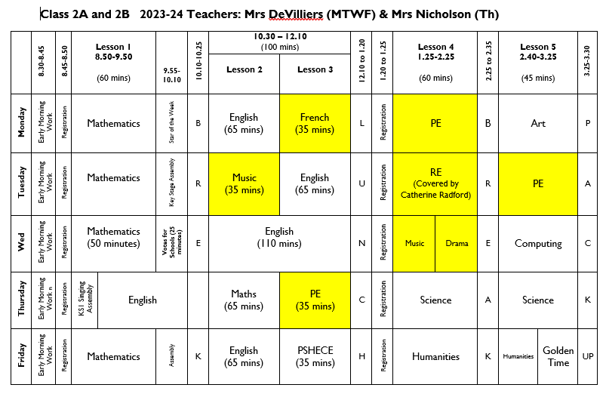
Notes:
Louise

Slide 9
Reading - Please listen to your child read five times a week. 10 10 minutes per day is better than a single long session. A book will be sent home and changed when finished.
Homework – Spellings will be sent home on Friday and will be tested the following Thursday. Children will also be set homework on Fridays which will be due in the following Thursday. Spellings will also be on Firefly and Spelling Shed.
Homework and a summary of our learning for the week will be in a weekly Home Learning letter, which will be posted on Firefly each Friday. You can also see photos of our learning.
Mathletics will continue to be offered across all year groups in the Prep School from September 2024.
Notes:
Alison

Slide 10
Gold Award
The Gold Award can be completed during Year 2. The Year 1 children have worked hard to complete a range of the activities and have enjoyed sharing their pieces of work with their classmates. This can continue into Year 2.
Each time a task is completed children should show the booklet to their class teacher to earn a star. Children will continue their booklet in which there are a total of 12 activities.
Children may complete some, or all of the activities shown and will be rewarded for their work.
4 stars = Bronze Certificate
8 stars = Silver Certificate
12 stars = Gold Badge
This is an optional activity.
.
Notes:
Daisy

Slide 11
Communication
You can catch us with small queries in the morning or after school; either the teacher or teaching assistant will be available.
If you require a longer appointment, please put a note in the homework diary or make contact with the Prep Office.
When appropriate we will make comments in your child’s homework diary or reading record.
In addition, please read the Friday weekly newsletter, and where appropriate share with your child’s other carers, as this outlines key dates and gives important information such as when Mufti days are happening.
Notes:
Louise

Slide 12
Class Teacher
Set Teacher
Specialist Teacher
Head of Key Stage, Mrs Lester
Academic – Director of Studies, Christina Hubbard
Pastoral – Head of Prep School, Mrs Shackel
We firmly believe that a problem
shared is a problem halved!
Notes:
Alison

Slide 13
Safeguarding
Safeguarding
There is a tab on the website about this – please take the time to read it.
Mobile Phones – not allowed at all in or around the Foundation Stage (legal requirement).
Videos and Mobile phones – see policy on website. Please do not use cameras in school unless allowed to do so at Productions or special events.
Any photos or videos MUST NOT be uploaded to social network sites (parents always tell us when it happens and who has done it!)
Notes:
Daisy

Slide 14
Safeguarding
When coming onsite during the school day (late, early, to drop something off) please go to the Prep office and not to your child’s class.
Nursery parents if collecting or dropping off at lunchtime please do not wander amongst the children on the playground.
Gates - please ensure you close gates behind you, especially those around the Foundation Stage which need to be locked.
Any concerns about a child’s welfare please raise with the class teacher first and then this will be passed on to our Designated Safeguarding Leader, Mrs Shackel.
Notes:
Louise

Slide 15
E-safety
In September we will be re-issuing our e-safety agreement for the children in Years 1-6, which will continue to be age specific.
These will be formally introduced or revisited by pupils in all year groups pupils through a series of cartoon clips during form time.
Children and parents will have to sign the agreements at the start of each academic year (Year 1 – Year 6).
When you receive the agreement please read, discuss and sign it with your child.
School will continue to use the SMART acronym as the basis for these rules.
S (safe) M (meeting) A (accepting) R (reliable) T (tell)
More information about the SMART principles will
be sent with the agreement in a parent mailing in
the first week of the Autumn Term.
Notes:
JR

Slide 16
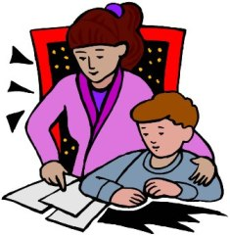
Ways to help
Encourage your child to be independent
with their possessions.
Support with homework as required.
Regular reading and spelling practice.
Encourage children’s interest in our topics e.g. visit to London in the Summer term, library books etc.
NAME ALL ITEMS OF CLOTHING PLEASE.
Notes:
Alison

Slide 19
We very much look forward to welcoming all of the children into Year 2.
In the meantime, we hope you have a wonderful Summer.
Notes:
Louise

